Slide 1
POETRY OF ILLNESS
Johanna Shapiro, PhD
Professor Emerita, Department of Family Medicine
University of California Irvine, School of Medicine

Slide 2


Introductory Sharing
Something about me
Something about you
  Why are you taking this class?
  What do you think is the connection between literature and medicine?

Slide 3

Why Do Patients Write?
Control/empowerment
To be seen, heard
Tell a story not often told in medicine – reclaim voice
Create beauty, meaning out of something ugly, empty
Create community, solidarity
Legacy – I was here

Slide 4

POETRY – WHAT IS IT?
Literary work in which special intensity is given to the expression of feelings and ideas by the use of distinctive style and rhythm
Writing that formulates a concentrated imaginative awareness of experience in language chosen and arranged to create a specific emotional response through meaning, sound, and rhythm

Slide 5
Poets Define Poetry
A poem is being, against emptiness. Miroslav Holub, Czech poet and physician
No poem solves life…. The whole artistic enterprise is a kind of holding action, it’s a little bridgehead for the spirit. – Seamus Heaney, Irish poet
It is difficult to get the news from poems, yet men die miserably every day from lack of what is found there. – William Carlos Williams, American physician and poet
If I read a book and it makes my whole body so cold no fire can warm me, I know that is poetry. If I feel physically as if the top of my head were taken off, I know that is poetry. These are the only ways I know it. Is there any other way? Emily Dickinson, American poet
… poems are not words, after all, but fires for the cold, ropes let down to the lost, something as necessary as bread in the pockets of the hungry. — Mary Oliver, American poet

Slide 6

Poetry and Grace from Some Like Poetry
Bruce Bennett Wislawa Szymborska
Poetry is not grace;
It can’t absolve
A sinner, or replace
Lost faith, or solve
Conundrums by what’s learned
Beyond the grave.
But it is swift, unearned,
And it can save.
Poetry –
but what sort of thing is poetry?
Many a shaky answer
has been given to this question.
But I do not know and do not know and hold on to it,
as to a saving banister.

Slide 7

Special Features of Poetry for Physicians and Healthcare Professionals

Slide 8

Ground Rules for Readings
1) You can ask me anything!
  About the writing
  About the events described
  About my thoughts and feelings
2) How did the poem make you feel?
3) What did the poem make you think about?
4) What did you learn about the narrator?
5) What did you learn from the poem that might help you as a future physician?
6) If the narrator were your patient, what would you want to ask her? What would you want to say to her?

Slide 9
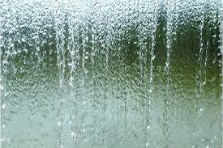
The Transformation of Water
In the beginning was the Word
Across a great body of water
a Japanese scientist
fills beakers with
molecularly identical
water samples
then affixes labels to each:
joy, rage, peace, despair
When next he analyses
the beakers’ contents,
each contains a radically
altered organization
of molecules –
water transformed
by words
Outside the Cancer Center
I pause, watching translucent
beads and rivulets of water
cascading down
a decorative stone wall,
seeking words
powerful enough
magical enough
to change the
molecular structure
of sarcoma
or at least transform
the fear of death

Slide 10
Neighbors
We both joined the local Neighborhood Watch
to guard against suspicious elements
so he keeps an eye on me
- and I on him
Every so often, he borrows a cup of sugar
(so old-fashioned!)
I do not borrow anything from him
as I do not wish to be in his debt
I admit to some of the usual prejudices
before I got to know him better
The skeletal hands hanging menacingly
from that creepy robe
The hood, the scythe – it was so over the top
Death is not my lover
- that would be morbid -
nor even my best friend
- though some say he can be that -
He is merely become
my near neighbor
having taken up residence next door
We are friendly
in a cool sort of way
Sometimes we wave
when we are pulling out from our driveways
I off to my work
he off to… his

Slide 11

Neighbors cont
Nothing certain but death and taxes
he likes to joke
Of course, we have the occasional
neighborly dispute
- my hedge is grown too high
his dog leaves unwanted gifts on my lawn –
But we work it out
That’s what neighbors do
And when at last I take that long trip
into eternity
I will have no qualms
about asking him to collect my mail
But in person he is more ordinary
He doesn’t even know how to play chess
and he is fond of gardening –
for which you must agree the scythe
makes some sense
In fact, as Miss Dickinson surmised,
he is a perfect gentleman
Although he works hard
he is never too busy to stop and chat
Do I think it looks like rain? he’ll ask
Or have I heard our property taxes are
going up…
again?

Slide 12
Etiquette for the Very Ill
Let’s say you get cancer
or have a heart attack
or get hit by a bus
You may think you need a doctor
or a hospital
But what you really need
is a lesson in etiquette
Otherwise you will end up
making a very bad impression
on friends, family,
doctors, nurses,
and complete strangers
so that
while struggling to live
or struggling to die
you will also be universally perceived
as completely lacking
in decorum
Etiquette
That’s right
By getting so sick
you’ve just committed
a serious social faux pas
That’s French for
a fucking bad mistake
from which you will probably
never recover
Ha-ha
(Generally speaking,
as a very sick person,
you want to avoid mordant humor
But what’s a joke or two
among friends?)

Slide 13
Etiquette cont.
Believe me,
when you are a very sick person
you need etiquette
Lesson #1
It is a good idea
when you are desperately ill
to know a little French
French is a classy language
and as a very ill person,
it will give you a certain
je ne sais quoi
(That’s French too
Look it up)
If you do not already
know French
you will have plenty of time
to learn it
in doctors’ waiting rooms
Lesson #2
When you become
a very ill person
it is most important
that you avoid self-pity
This is a very disagreeable emotion
to others
Also anger, despair, misery (especially
the wallowing kind) are bad
Bitter is very bad
When you show these emotions
You make healthy people
feel guilty and uncomfortable
Healthy people can be unkind
They have plenty of energy

Slide 14
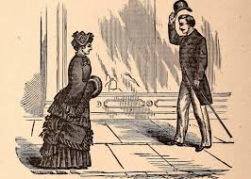
Etiquette cont.
Leson #3
As you might imagine,
smiling is never out of place
If you aren’t very ill yet
try smiling as you stick a
needle (an ordinary sewing needle is fine)
under your fingernail
You can add “thank you” later
If you allow yourself to become
a very ill person who behaves badly
then it will end very badly for you
because everyone will despise you
for having atrocious manners
On the other hand,
it will probably end very badly for you
anyway.

Slide 15
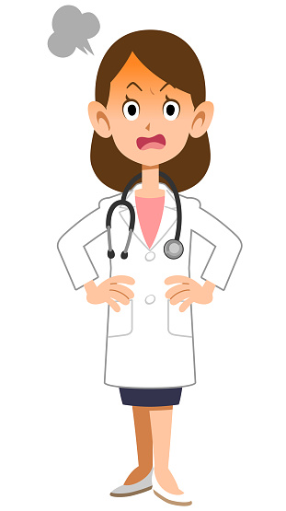
Too Soon
We glance about
surreptitiously
and giggle at our own mischief
Who do we think is watching?
God, with His infinite storehouse
of plagues and vermin?
Or my doctor
who has her own commandments
and is likely the sterner taskmaster
Too soon after my surgery
we sneak out to breakfast
truant school kids
in search of guilty pleasures
But we are grandparents
respectable if rickety
The tang of sea-stroked breeze
is only made keener
and the succulence of the
fruit and yogurt sweeter
by the knowledge of risk

Slide 16

SMALL GROUP DISCUSSION
1) How did the poem make you feel?
2) What did the poem make you think about?
3) What did you learn about the narrator?
4) What did you learn from the poem that might help you as a future physician?
5) If the narrator were your patient,
a) what would you want to ask her?
b) what would you want to say to her?

